Slide 1
network layer Bitcoin deanonymizer
Group Members
Himanshu Patel
Dhwanil Desai
Samarth Desai

Slide 2
What is bitcoin

Slide 3
Cryptocurrency and worldwide payment system
First decentralized digital currency
Distributed Network
Blockchain and without an intermediary.
Transaction verified by network nodes through the use of Cryptography and Blockchain
Miners role in bitcoin

Slide 4
What are Bitcoin Transactions?

Slide 5
It is a straight process between owner and receiver
Broadcasted through P2P network
All transactions are public but still anonymous (Private key)
Mining node collect the transactions into blocks

Slide 6
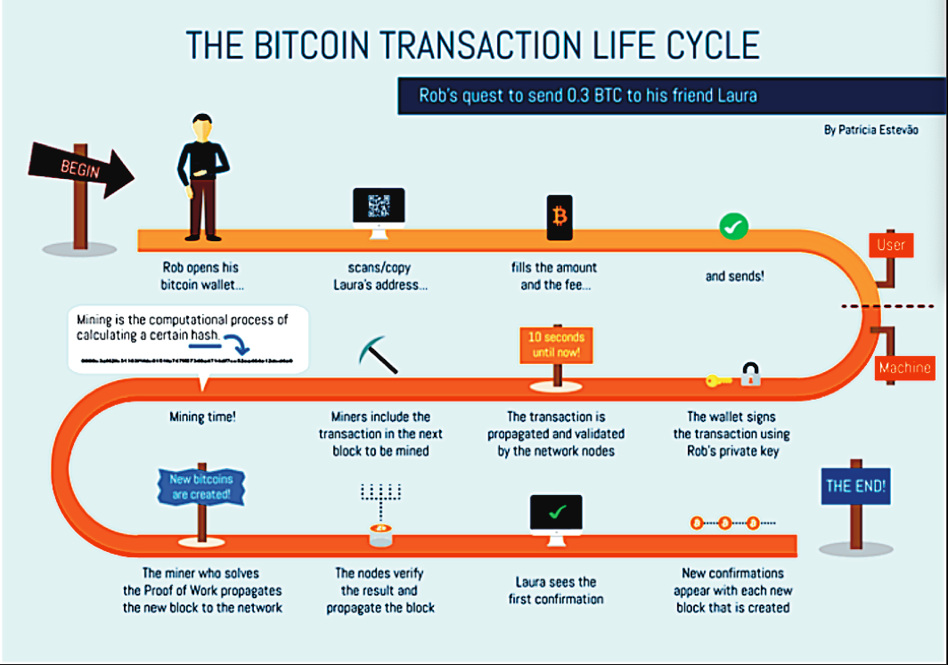

Slide 7
Deanonymization
Directly transacting
Via service providers
Carelessness
Above method known as transaction graph analysis.
Notes:
Anyone who transacts with an individual — an online or offline merchant,knows at least one address belonging to them.
In the course of using Bitcoin over a few months or years, most users will end up interacting with an exchange or another centralized service provider. This service typically providers ask users for their identities.
People often post their Bitcoin addresses in public forums. A common reason is to request donations. When someone does this it creates a link between their identity and one of their addresses. If they don’t use the anonymity services that we’ll look at in the following sections, they risk having all their transactions de-anonymized.

Slide 8
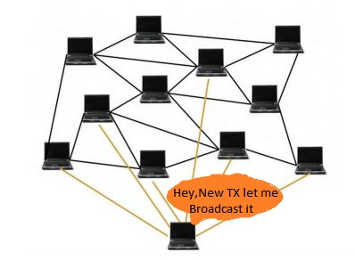
Deanonymization in Networking terminology
First pointed out by Dan Kaminsky at Black Hat Conference
Transaction on the nodes get broadcasted.
If these nodes is control by an adversary
Transaction can be link to node’s IP address

Slide 9
Our Method

Slide 10
Getting the peers

Slide 11
Listening to messages from peers
Notes:
Processing 3000 to 4000 transaction messages

Slide 12
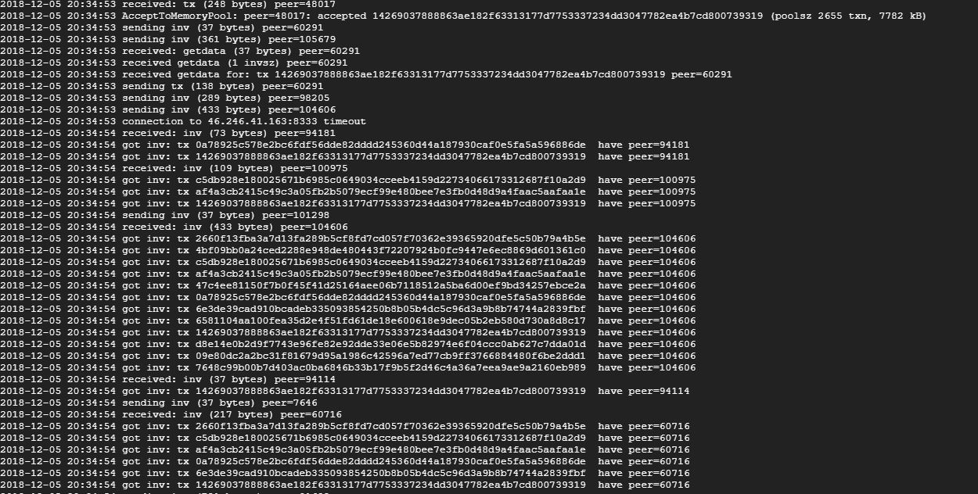

Slide 13
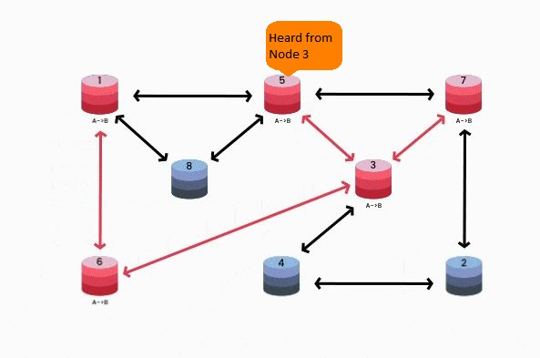
FIRST TRANSACTION
2018-12-05 19:38:06 AcceptToMemoryPool: peer=37661: accepted cea18fc1b091a5844cb65a585d0145218dd6a6e871c91b8e925e19ac05b6a071 (poolsz 6264 txn, 15240 kB)

Slide 14
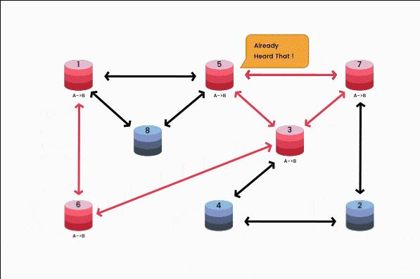
Second transaction
2018-12-05 19:38:06 got inv : tx cea18fc1b091a5844cb65a585d0145218dd6a6e871c91b8e925e19ac05b6a071 have peer id:92323

Slide 15
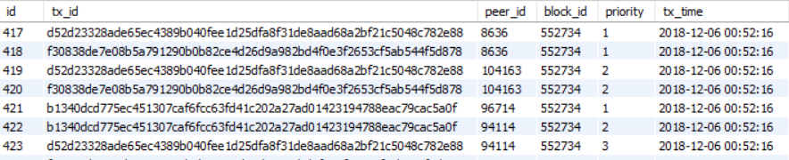
Few Transactions from our sql table

Slide 16
Linking Transaction with real world entity
Python file(get_peer.py) to get the list of peers
Storing information like (Peer_id,ASN,IP’s ISP name etc) in SQL table.
Linking the peer id with the Transactions peer id.

Slide 17
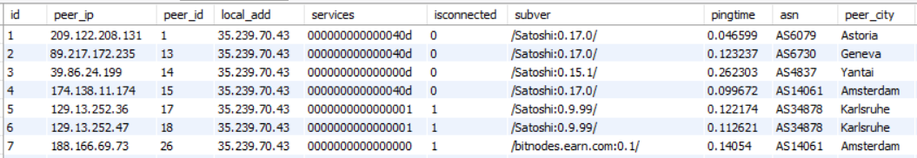
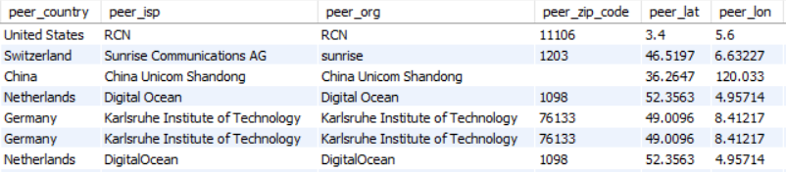
Peer list from our sql table

Slide 18
Demo link
The first link will show all connected countries with number of nodes
1.http://35.239.70.43/countries.html
This link will show current connected peers
2.http://35.239.70.43/live_tx_ip.html
This link will show current transactions
3.http://35.239.70.43/live_tx.html

Slide 19
Results

Slide 20
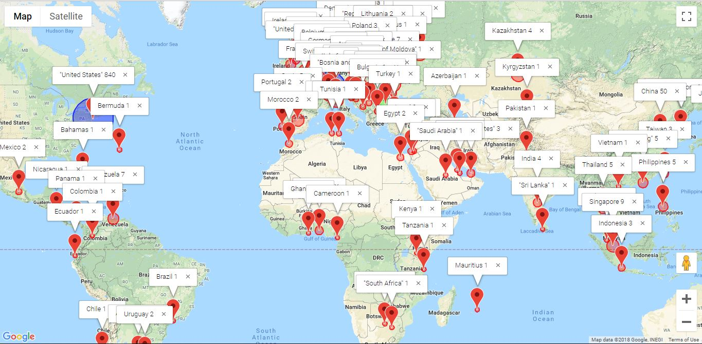
Countries from which nodes were connected

Slide 21
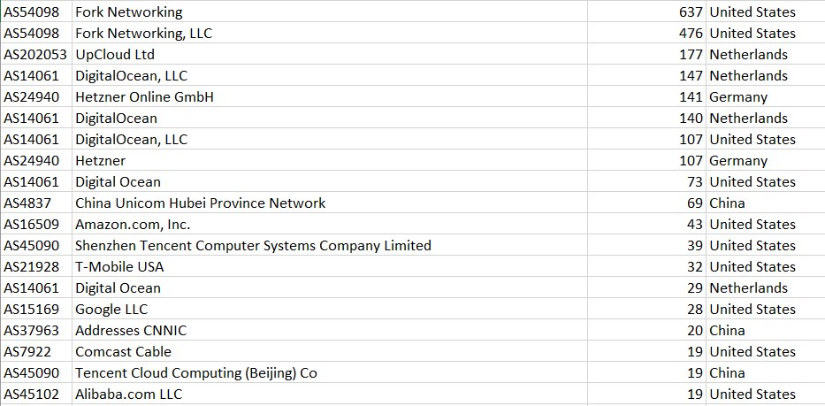
Top 20 ASN/organization hosting bitcoin nodes

Slide 22
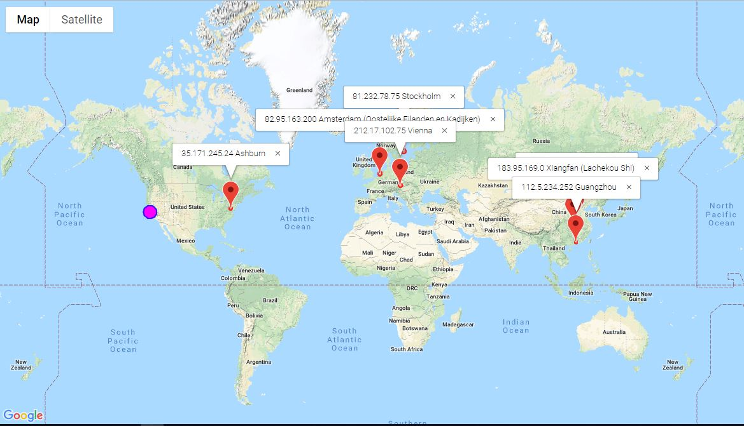
Live Transactions over connected IP’s

Slide 23
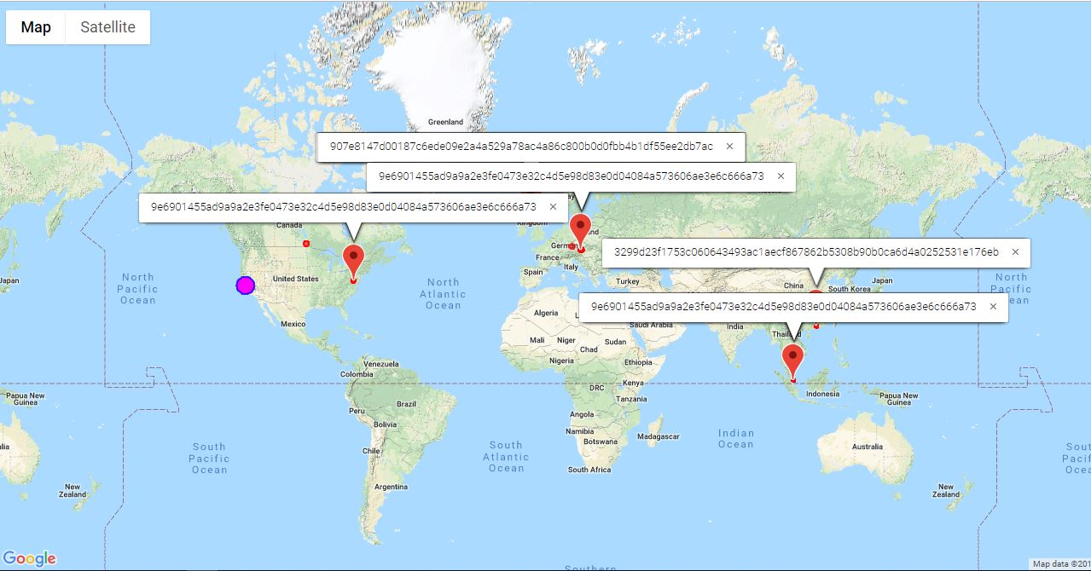
Live transactions

Slide 24
QUESTIONS

